Slide 1
(2 * 3) + (2 / 4) – (4 + 3)
Find Prefix - + * 2 3 / 2 4 + 4 3
Evaluate Prefix
Find Postfix 2 3 * 2 4 / + 4 3 + -
Evaluate Postfix

Slide 2
Queues

Slide 3
Introduction to Queues
A queue is a waiting line – seen in daily life
A line of people waiting for a bank teller
A line of cars at a toll both
What other kinds of queues can you think of
The queue has a front and a rear.
$ $
Rear
Front

Slide 4
In Queue
Items can be removed only at the front
Items can be added only at the other end, the back
1 2 3
Original Queue
Front Rear
Add 4 to the Queue
1 2 3 4
Front Rear
2 3 4
Remove the element
from the Queue
Front Rear

Slide 5
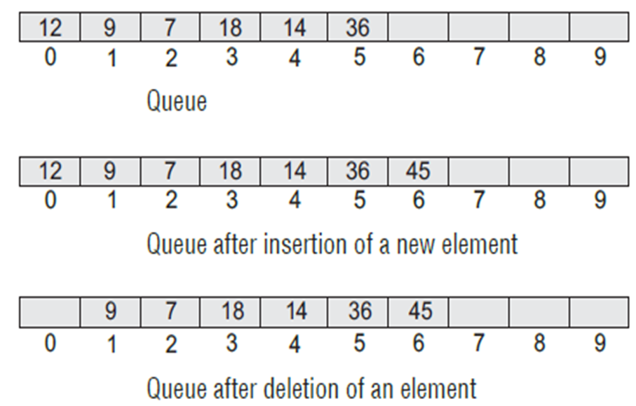
The Queue As an ADT
A queue is a sequence of data elements
Basic operations
Enqueue (add element to back)
Dequeue (remove element from front)
Enqueue & Dequeue operations

Slide 6
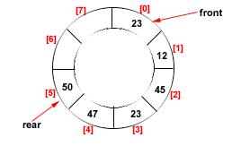
Types Of Queues
Linear Queue
Circular Queue
Double Ended Queue (Deque)
Priority Queue

Slide 7
Double Ended Queue
Double ended queues, called deques for short, are a generalized form of the queue. It is exactly like a queue except that elements can be added to or removed from the head or the tail.
However, no element can be added and deleted from the middle.
In the computer’s memory, a deque is implemented using either a circular list or a circular doubly linked list.
In a deque, two pointers are maintained, LEFT and RIGHT, which point to either end of the deque. The elements in a deque extend from the LEFT end to the RIGHT end and since it is circular, Dequeue[N–1] is followed by Dequeue[0].

Slide 8
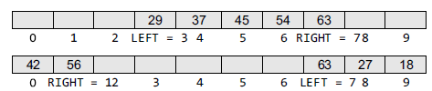
There are two variants of a double-ended queue. They include :
Input restricted deque In this, insertions can be done only at one of the ends, while deletions can be done from both ends.
Output restricted deque In this deletions can be done only at one of the ends, while insertions can be done on both ends.
deque is useful for priority queuing.
A deque can model a station where cars can enter and leave on the left or right side of a line, but only the cars at the ends can move in and out.
common application of the deque is storing a software application's list of undo operations.

Slide 9
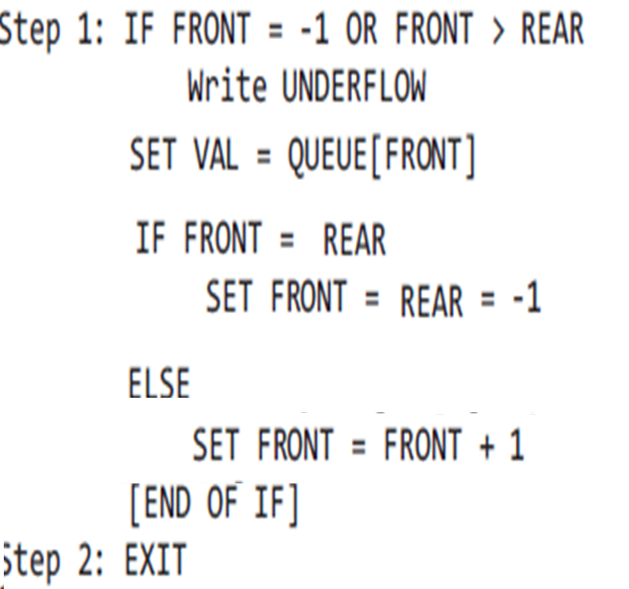
Array Implementation -Dequeue
When an item is taken from the queue, it always comes from the front.
This a dequeue operation.

Slide 10
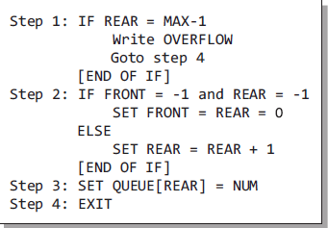
Array Implementation -Enqueue
When an item is inserted into the queue, it always goes at the end (rear).
This a enqueue operation.

Slide 11
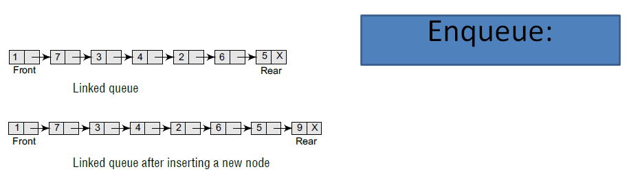
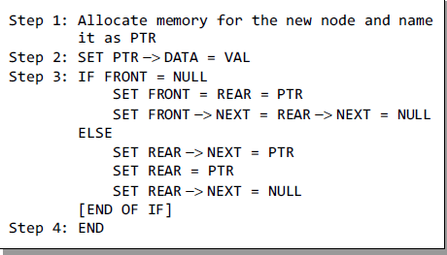
LINKED REPRESENTATION OF QUEUEs

Slide 12
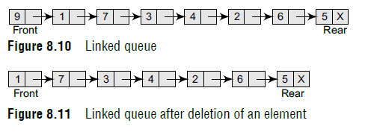
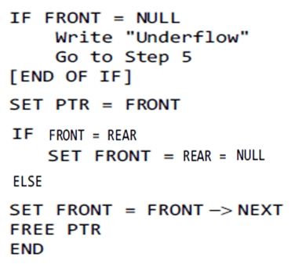
Dequeue

Slide 13
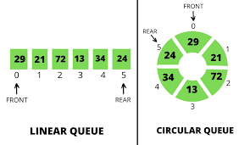
Circular Queue

Slide 14
Drawback of Linear Queue
Once the queue is full, even though few elements from the front are deleted and
some occupied space is relieved, it is not possible to add anymore new elements,
as the rear has already reached the Queue’s rear most position.
Circular Queue
This queue is not linear but circular.:
In circular queue, once the Queue is full the
"First" index of the Queue becomes the
"Rear" most index, if and only if the "Front" element has moved forward. otherwise it will be a "Queue overflow" state.
Circular Queue having
Rear = 5 and Front = 0
09/10/08
14

Slide 15
Algorithms for Insert Operations in Circular Queue
For Insert Operation
Insert-Circular-Q(CQueue, Rear, Front, N, Item)
Here, CQueue is a circular queue.
Rear represents the location in which the data element is to be inserted and
Front represents the location from which the data element is to be removed.
N is the maximum size of CQueue and
Item is the new item to be added.
Initailly Rear = -1 and Front = -1.
1. If Front = -1 and Rear = -1 then Set Front = Rear = 0 and go to step 5.
2. Else If Front =0 and Rear = N-1 or Front = Rear + 1
then Print: “Circular Queue Overflow” and Return.
3. Else If Rear = N -1 then Set Rear := 0 and go to step 5.
4. Else Rear = Rear + 1
5. CQueue [Rear] := Item
6. Return
09/10/08
15

Slide 16
For Delete Operation
Delete-Circular-Q(CQueue, Front, Rear, Item)
CQueue is the place where data are stored.
Rear represents the location in which the data element is to be inserted and
Front represents the location from which the data element is to be removed. Front element is assigned to Item.
Initially, Front = -1.
*..Delete without Insertion
If Front = -1 then Print: “Circular Queue Underflow” and Return.
Set Item := CQueue [Front]
3. If Front = N – 1 then Set Front = 0 and Return.
4. If Front = Rear then Set Front = Rear = -1 and Return.
5. Set Front := Front + 1
6. Return.
09/10/08
16

Slide 17
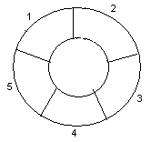
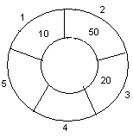
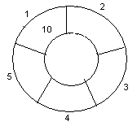
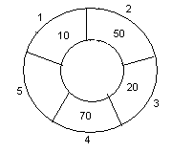
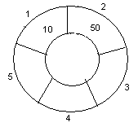
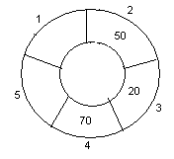
Example- ENQUEUE
Circular queue with N = 5.
(Assume Index starts with 1)
1. Initially, Rear = 0, Front = 0.
4. Insert 20, Rear = 3, Front = 1.
Front
Rear
Rear
2. Insert 10, Rear = 1, Front = 1.
5. Insert 70, Rear = 4, Front = 1.
Front
Front
Rear
3. Insert 50, Rear = 2, Front = 1.
6. Delete , Rear = 4, Front = 2.
Front
Rear
Front
09/10/08
17
Rear

Slide 18
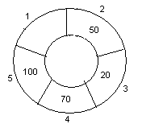
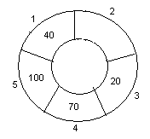
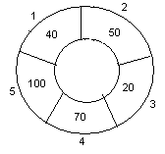
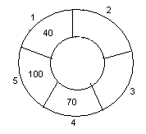
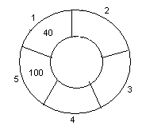
ENQUEUE/DEQUEUE
Circular queue with N = 5.
7. Insert 100, Rear = 5, Front = 2.
10. Delete, Rear = 1, Front = 3.
Front
Rear
Front
Rear
8. Insert 40, Rear = 1, Front = 2.
11. Delete, Rear = 1, Front = 4.
Rear
Rear
Front
Front
9. Insert 140, Rear = 1, Front = 2.
As Front = Rear + 1, so Queue overflow.
12. Delete, Rear = 1, Front = 5.
Rear
Rear
Front
Front
09/10/08
18

Slide 19
Example- ENQUEUE / DEQUEUE
Circular queue with N = 5.
( Index starts with 0)
7. Insert 100.
1. Initially empty Queue
8. Insert 40.
2. Insert 10,
9. Insert 140.
3. Insert 50,
10. Delete front,
4. Insert 20,
11. Delete front.
5. Insert 70,
6. Delete front,.
12. Delete front.
ENQUEUE
Initailly Rear = -1 and Front = -1.
1. If Front = -1 and Rear = -1 then Set Front :=0 and go to step 4.
2. If Front =0 and Rear = N-1 or Front = Rear + 1
then Print: “Circular Queue Overflow” and Return.
3. If Rear = N -1 then Set Rear := 0 and go to step 4.
Set Rear:=Rear + 1 and CQueue [Rear] := Item.
5. Return
DEQUEUE
Initially, Front = -1.
If Front = -1 then Print: “Circular Queue Underflow” and Return.
Set Item := CQueue [Front]
3. If Front = N – 1 then Set Front = 0 and Return.
4. If Front = Rear then Set Front = Rear = -1 and Return.
5. Set Front := Front + 1
6. Return.
09/10/08
19

Slide 20
Example- ENQUEUE / DEQUEUE
Circular queue with N = 5.
(Index starts with 0)
1. Initially, Rear = -1, Front =-1
2. Insert 10, Rear = 0, Front = 0.
8. Insert 40, Rear = 0, Front = 1.
3. Insert 50, Rear = 1, Front = 0.
9. Insert 140, Rear = 0, Front = 1.
As Front = Rear + 1, so Queue overflow.
Rear
4. Insert 20, Rear = 2, Front = 0.
5. Insert 70, Rear = 3, Front = 0.
10. Delete front, Rear = 0, Front = 2.
11. Delete front, Rear = 0, Front = 3.
6. Delete front, Rear = 3, Front =1.
12. Delete front, Rear = 0, Front = 4.
7. Insert 100, Rear = 4, Front = 1.
09/10/08
20

Slide 21
Example- ENQUEUE / DEQUEUE
Circular queue with N = 4.
( Index starts with 0)
7. Insert 100, 320, 400.
1. Initially empty Queue
8. Delete
2. Insert 100, 120, 130
9. Insert 140.
3. Insert 150, 200
10. Delete ,
4. Delete, Delete
11. Delete
5. Insert 70,
6. Delete, Delete .
12. Insert 34
Find the value of Front and Rear after performing all operations
How many Overflows are identified and for which values?
How many times underflow encountered ?
09/10/08
21

Slide 22
Double Ended Queue
Double ended queues, called deques for short, are a generalized form of the queue. It is exactly like a queue except that elements can be added to or removed from the head or the tail.
However, no element can be added and deleted from the middle.
In a deque, two pointers are maintained, LEFT and RIGHT, which point to either end of the deque. The elements in a deque extend from the LEFT end to the RIGHT end and since it is circular, Dequeue[N–1] is followed by Dequeue[0].

Slide 23
There are two variants of a double-ended queue. They include :
Input restricted deque In this, insertions can be done only at one of the ends, while deletions can be done from both ends.
Output restricted deque In this deletions can be done only at one of the ends, while insertions can be done on both ends.

Slide 24
Deque working
Deque reflects Stack and Queue both
(i.e. perform LIFO and FIFO execution)
In default operation of queue it works on FIFO principle
(i.e. operation that performs insertions at end(rear) and deletion from start(front))
In reverse case it works on LIFO principle
(i.e. operation that performs insertions at start(front) and deletion from end(rear))
start
end
Enqueue (stack)
Enqueue (queue)
dequeue(queue)
dequeue (stack)

Slide 25
Working
Operation from the end
Enqueue => R = R +1 if R = N-1 => R= 0
Dequeue => R = R -1 if R = 0 => R= N-1
Operation from the Start
Enqueue => F = F – 1 if F = 0 => F = N-1
Dequeue => F = F + 1 if F = N-1 => F = 0
Initially set F = R = -1
If F = R = -1 (represent empty queue)
For enqueue F = R = 0
For dequeue => Underflow
If F = R = 0 (represent only one element)
For dequeue F = R = -1
If F = 0 and R = N-1 OR F = R + 1 (represent queue is full)
For enqueue => Overflow

Slide 26
Assume that the Queue allows both operations from either end
Queue Size 4
Insert at start (10)
Insert at start (20)
Delete at end
Insert at end (30)
Insert at end (40)
Delete at start
Insert at start (50)
Delete at start
Delete at end
Delete at end

Slide 27
Queue Size 4
Insert at start (10)
Insert at start (20)
Delete at end
Insert at end (30)
Insert at end (40)
Delete at start
Insert at start (50)
Delete at start
Delete at end
Delete at end
 | 0 | 1 | 2 | 3
Insert at start (10) | 10
 | F R
Insert at start (20) | 10 |  |  | 20
 | R |  |  | F
Delete at end |  |  |  | 20
 |  |  |  | F=R
Insert at end (30) | 30 |  |  | 20
 | R |  |  | F
Insert at end (40) | 30 | 40 |  | 20
 |  | R |  | F
Delete at start | 30 | 40
 | F | R
Insert at start (50) | 30 | 40 |  | 50
 |  | R |  | F
Delete at start | 30 | 40
 | F
Delete at end | 30
 | F=R
Delete at end | F=R=-1
Operation from the end
Enqueue => R = R +1 if R = N-1 => R= 0
Dequeue => R = R -1 if R = 0 => R= N-1
Operation from the Start
Enqueue => F = F – 1 if F = 0 => F = N-1
Dequeue => F = F + 1 if F = N-1 => F = 0
Initially set F = R = -1
If F = R = -1 (represent empty queue)
For enqueue F = R = 0
For dequeue => Underflow
If F = R = 0 (represent only one element)
For dequeue F = R = -1
If F = 0 and R = N-1 OR F = R + 1 (represent queue is full)
For enqueue => Overflow

Slide 28
Assume that the Queue allows both operations from either end
Queue Size 5
Insert at end (10)
Insert at start (20)
Insert at end (30)
Delete at start
Insert at end (40)
Delete at start
Delete at start
Insert at end (50)
Insert at start (60)
Delete at end
Delete at end
Operation from the end
Enqueue => R = R +1 if R = N-1 => R= 0
Dequeue => R = R -1 if R = 0 => R= N-1
Operation from the Start
Enqueue => F = F – 1 if F = 0 => F = N-1
Dequeue => F = F + 1 if F = N-1 => F = 0
Initially set F = R = -1
If F = R = -1 (represent empty queue)
For enqueue F = R = 0
For dequeue => Underflow
If F = R = 0 (represent only one element)
For dequeue F = R = -1
If F = 0 and R = N-1 OR F = R + 1 (represent queue is full)
For enqueue => Overflow

Slide 29
Priority Queues
A priority queue is a data structure in which each element is assigned a priority. The priority of the element will be used to determine the order in which the elements will be processed.
The general rules of processing the elements of a priority queue are
An element with higher priority is processed before an element with a lower priority.
Two elements with the same priority are processed on a first-come-first-served (FCFS) basis.

Slide 30
Video Lecture of the topic can be found at
Introduction to QUEUE data Structure
https://youtu.be/T33TIYqLz6Q
How to Implement Linear QUEUE using Array and Linked List
https://youtu.be/DQJ5TPb-PPA
Introduction to Circular Queue and Its implementation
https://youtu.be/ibsZemxgsXk
Understanding CIRCULAR QUEUE Operations with an Illustrative EXAMPLE
https://youtu.be/LI3pg0aU87A

